Slide 1
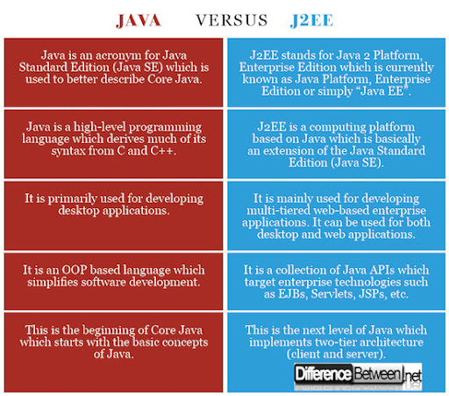

Slide 2
What are the two ways of multitasking in Java?
There are two types of multitasking:
Pre-emptive multitasking. In pre-emptive multitasking, the operating system decides how to allocate CPU time slices to each program. ...
Cooperative multitasking. In cooperative multitasking, each program controls how much CPU time it needs.

Slide 3
An application server is a server that hosts applications. ... An application server framework provides both facilities to create web applications and a server environment to run them. An application server framework contains a comprehensive service layer model.
What is application server examples?
Among the popular application server platforms are J2EE, WebLogic, Glassfish, JBoss Enterprise Application Platform, Apache Tomcat, and Apache Geronimo, to name but a few.

Slide 4
What are advantages of web services?
Web services use SOAP over HTTP protocol, so you can use your existing low-cost internet for implementing web services. This solution is much less costly compared to proprietary solutions like EDI/B2B. Besides SOAP over HTTP, web services can also be implemented on other reliable transport mechanisms like FTP.

Slide 5
what are the categories of enterprise Java Bean
There are three types of enterprise beans, entity beans, session beans, and message-driven beans. All beans reside in Enterprise JavaBeans (EJB) containers, which provide an interface between the beans and the application server on which they reside.

Slide 6
What is meant by web development frameworks?
A web development framework is a set of resources and tools for software developers to build and manage web applications, web services and websites. ... A web development framework can be built upon a pre-defined infrastructure such as the Linux, Apache, MySQL and PHP (LAMP) stack.

Slide 7
-MVC is an architectural pattern consisting of three parts: Model, View, Controller. Model: Handles data logic. View: It displays the information from the model to the user. Controller: It controls the data flow into a model object and updates the view whenever data changes.

